Slide 1
Carbohydrates Tests
Pharmacognosy
3rd Class, 1st Semester / 2023
By:
Ph Faten Essam
MSc pharmacy science

Slide 2
Carbohydrates
Class of naturally occurring compounds which are of great importance to human beings because is a key source of energy used by living things. They are major part of our diet, providing 60-70% of total energy required by the body. Also serve as extracellular structural elements as in cell wall of bacteria and plant.

Slide 3
General formula of carbohydrates
The chemical formula of a carbohydrate is (CH₂O)n . So the meaning of carbohydrate …………..

Slide 4
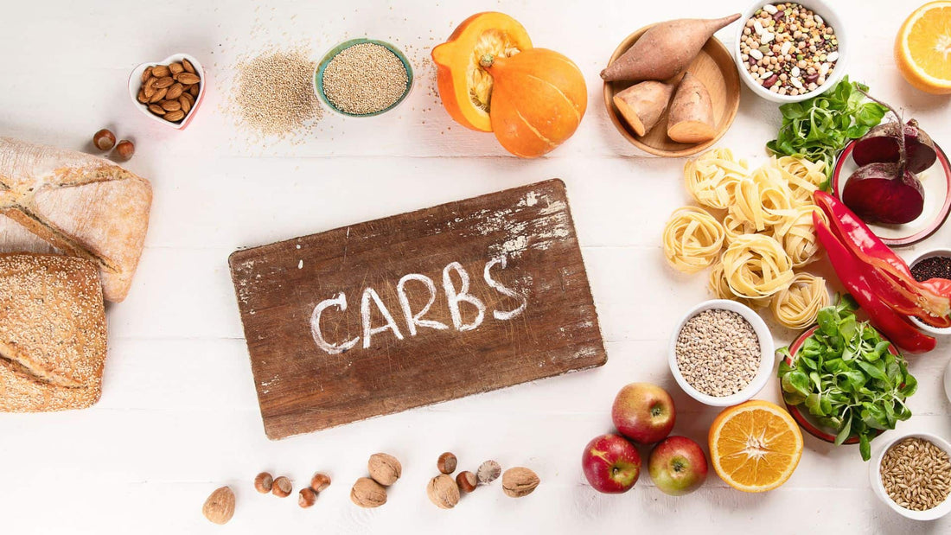
Sources of carbohydrate

Slide 5
Classifications of carbohydrates
Carbohydrates classified either according to complexity or according to the size

Slide 6

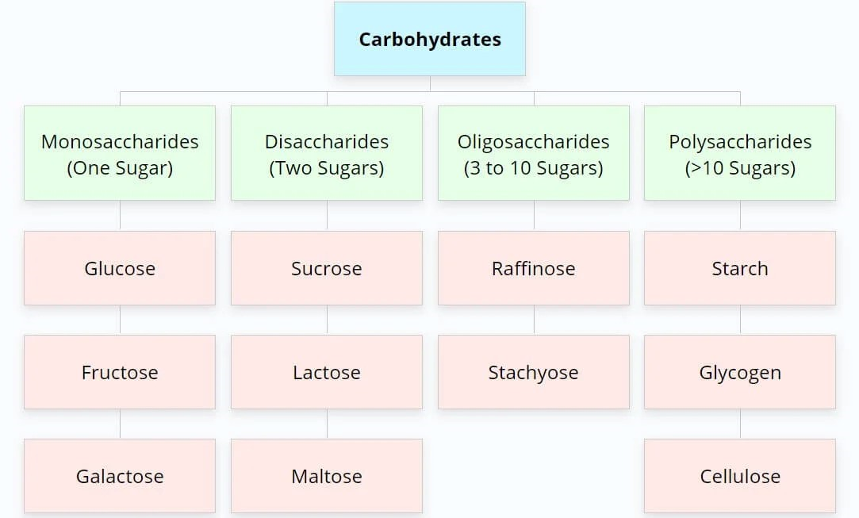
Classification of carbohydrate according to complexity
simple
complex

Slide 7
Classification of carbohydrate according to size

Slide 8
Chemical classification of carbohydrates
Chemically, Carbohydrates are aldehydes and ketones

Slide 9

Examples ??????

Slide 10
Properties:
Solubility of sugars [physical property]:
Monosaccharide and disaccharide can be dissolved freely in water because water is a polar substance, while polysaccharide cannot be dissolved easily in water, because, it has high molecular weight , which give colloidal solutions in water.

Slide 11
Carbohydrates tests
Molisch test:
This test is specific for all carbohydrates mono , di and polysaccharides
Objective:
To identify the carbohydrate from other macromolecules, lipids and proteins

Slide 12
Procedure
1- take 1 ml of test solution and add 1-2 drops of α- naphthol and mix it
2- then add H2SO4 (up to 2 ml ) drop by drop on the side of test tube until purple ring form (don’t shake it)
Observation
Violet ring appear at the junction between the two liquids
This indicate the presence of carbohydrate in solution

Slide 15
Iodine test
This is a specific test for polysaccharide helps to identify the presence of starch in a sample. It also helps to distinguish between mono– or disaccharides from polysaccharides (glycogen, dextrin, and amylase)
In which starch adsorb iodine to form dark blue color , while glycogen form brown – red color

Slide 16
Starch consist of amylose and amylopectin
In which glucose in amylose linked together by α1-4 glycosidic linkage give it straight form , while amylopectin glucose unit have branched unit (α1-6 glycosidic linkage ) give it branched form
Natural starch contains two monomeric units: Amylose (10-20%) and Amylopectin (80-90%).

Slide 17
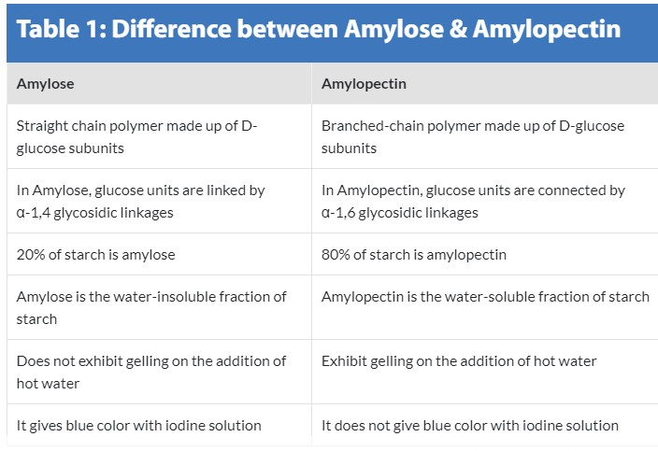

Slide 18
Principle of iodine test
Iodine forms a coordinate complex between the helically coiled polysaccharides chain and iodine centrally located within the helix due to adsorption.
The color obtained depends upon ………….

Slide 19
Procedure of iodine test
1- take 2ml of carbohydrate solution in test tube
2- add 1-2 drop of iodine solution and mix it
3. observe the results

Slide 20
Observation
1- if dark blue color this indicate the presence of starch (polysaccharide)
2- if brown – red color this indicate the presence of glycogen
3- if yellow color appear this indicate negative results (no polysaccharide in solution)

Slide 21
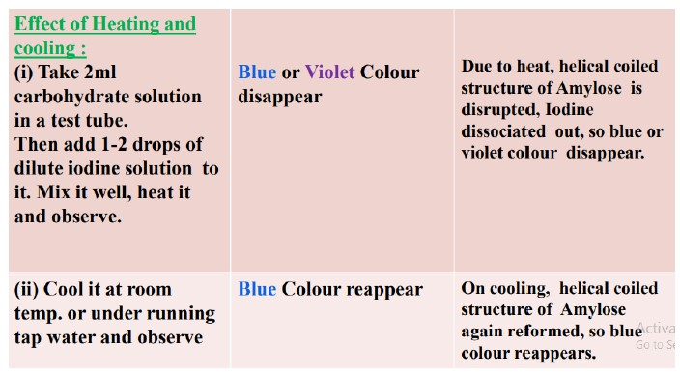

Slide 22


